Slide 1
AI Project Cycle
Unit II
MODELLING

Slide 2
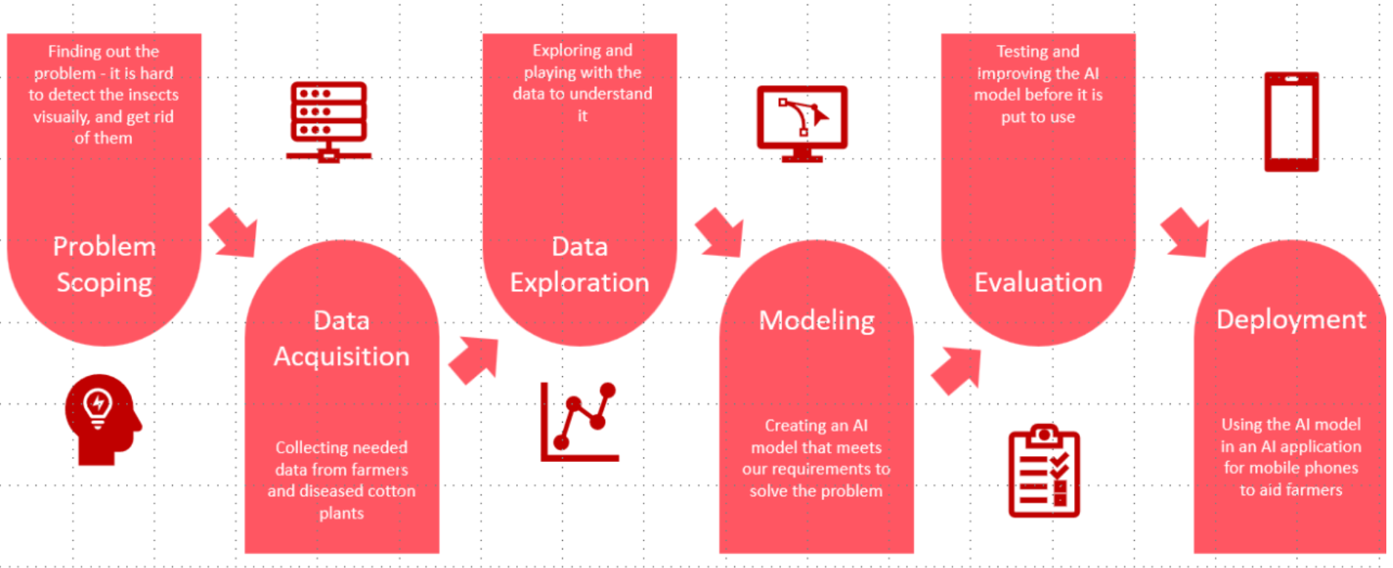
AI Project Cycle Map
Stages of AI Project Cycle

Slide 3
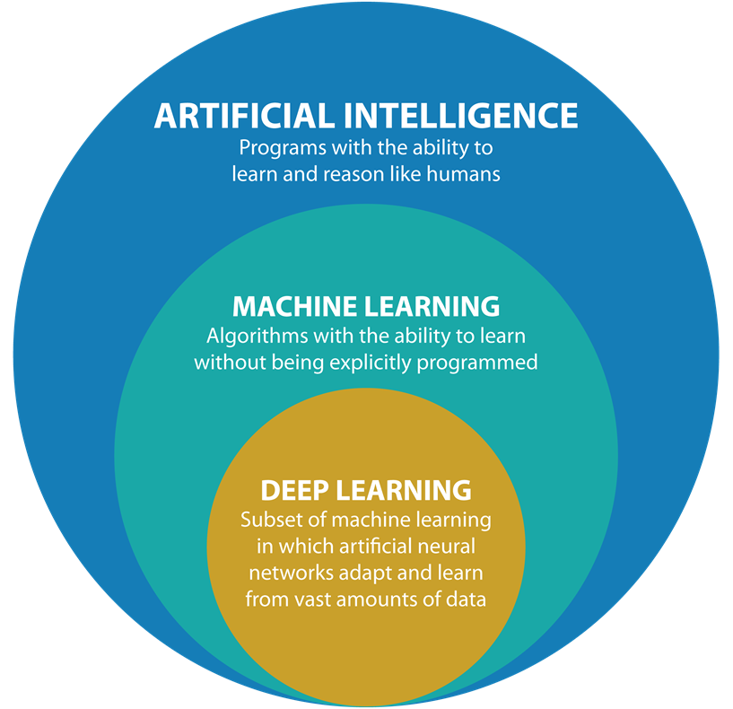
INTRODUCTION
In the previous session, you have learned to collect and visualize data. To build an AI project we need to work around AI models or algorithms. This could be done either by designing your own model or by using a pre-existing model.
AI modelling refer to developing algorithms, also called models which can be trained to get intelligent outputs. It involves writing codes to make a machine artificially intelligent.
Before jumping into modelling let us clarify the definitions of
Artificial Intelligence (AI),
Machine Learning (ML) and
Deep Learning (DL).

Slide 4
Artificial Intelligence
Artificial Intelligence, abbreviated as AI, is any method that makes computers replicate intelligent human behavior. The AI-enabled devices follow instructions intelligently and think in an algorithmic fashion.
Machine Learning
Machine learning, or ML, makes it possible for machines to get better at activities over time. The machine is capable of learning from its errors and applying those lessons to its subsequent operations. It uses its experiences to improvise on its own.
Deep Learning
Software can train itself to accomplish jobs using large volumes of data thanks to a technology called deep learning, or DL. Massive volumes of data are used in deep learning to train the computer so that it can learn to learn from the data itself. These devices are smart enough to create algorithms on their own.

Slide 5
AI Modelling
AI Modelling refers to developing algorithms, also called models which can be trained to get intelligent outputs. That is, writing codes to make a machine artificially intelligent.
AI Models
Rule-based Approach
Learning Approach

Slide 6
Model Types
A Rule based approach is generally based on the data and rules fed to the machine, where the machine reacts accordingly to deliver the desired output.
Through a learning-based approach, the machine is given data and the intended output, and it creates its own algorithm (or set of rules) to match the inputted data with the output that is sought.

Slide 7
Let’s Discuss…
Use your knowledge and thinking ability and answer the following questions:
What makes a machine intelligent?
How can a machine be artificially intelligent?
Can Artificial Intelligence be a threat to Human Intelligent? How?

Slide 8
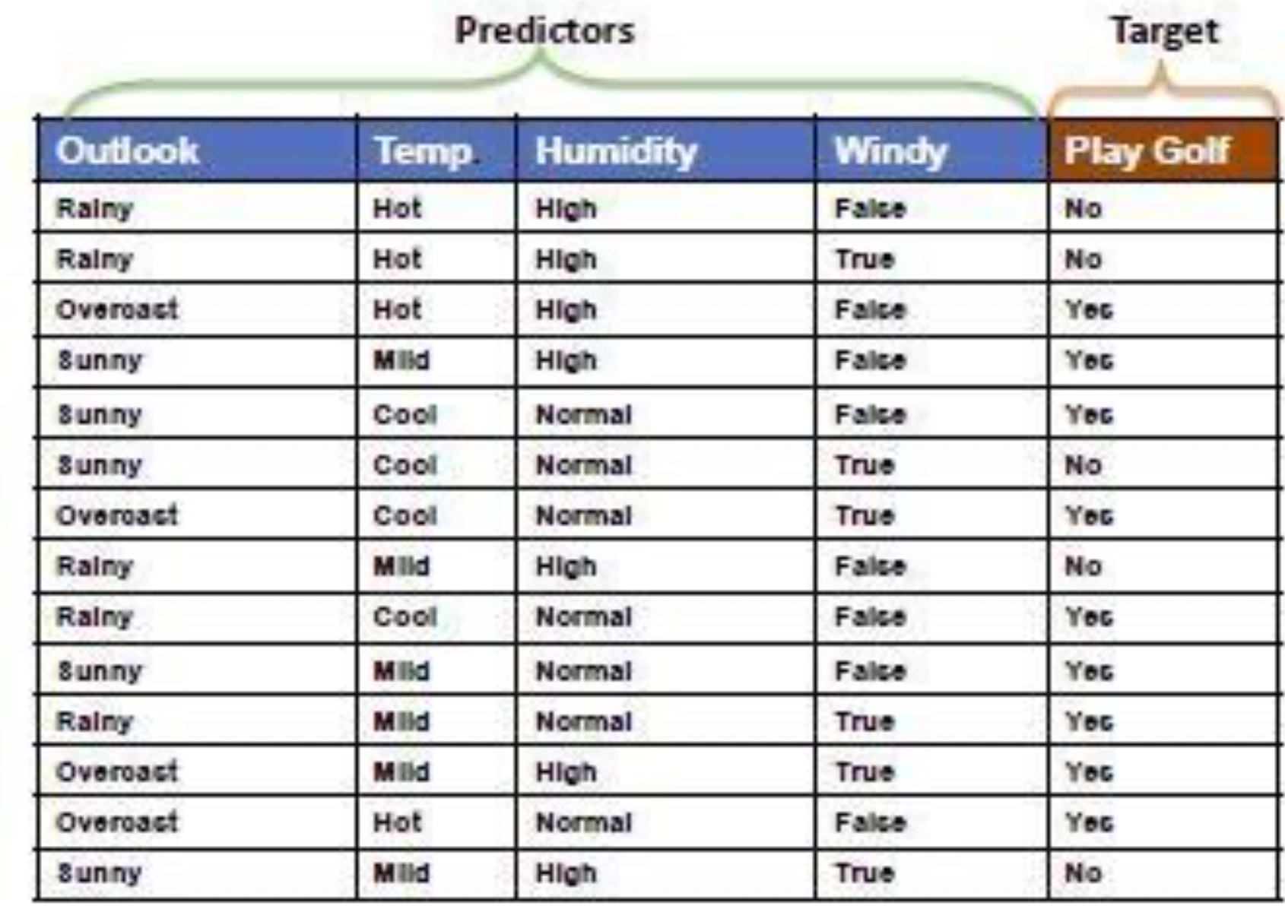
For instance, we have a dataset that explains the requirements that determine whether or not a child is allowed to go play golf. These are the parameters. : Wind, humidity, temperature, and outlook. Let's now explore different combinations of these characteristics to observe which of the following scenarios allows the kids to play golf and which does not. We send this data into the machine along with the rules that inform it all the possibilities after going through each scenario. After training on this data, the system is prepared for testing. We instruct the machine to expect overcast skies, normal temperatures, normal humidity, and weak winds when it is being tested. The machine will now be able to forecast whether or not the child can go outside to play golf based on this testing dataset, and it will show us the result.
1.Rule based Approach
Refers to the Al modelling where the rules are defined by the developer.
The machine follows the rules or instructions mentioned by the developer and performs its task accordingly.
We fed the data along with rules to the machine and the machine after getting trained on them is now able to predict answers for the same

Slide 9
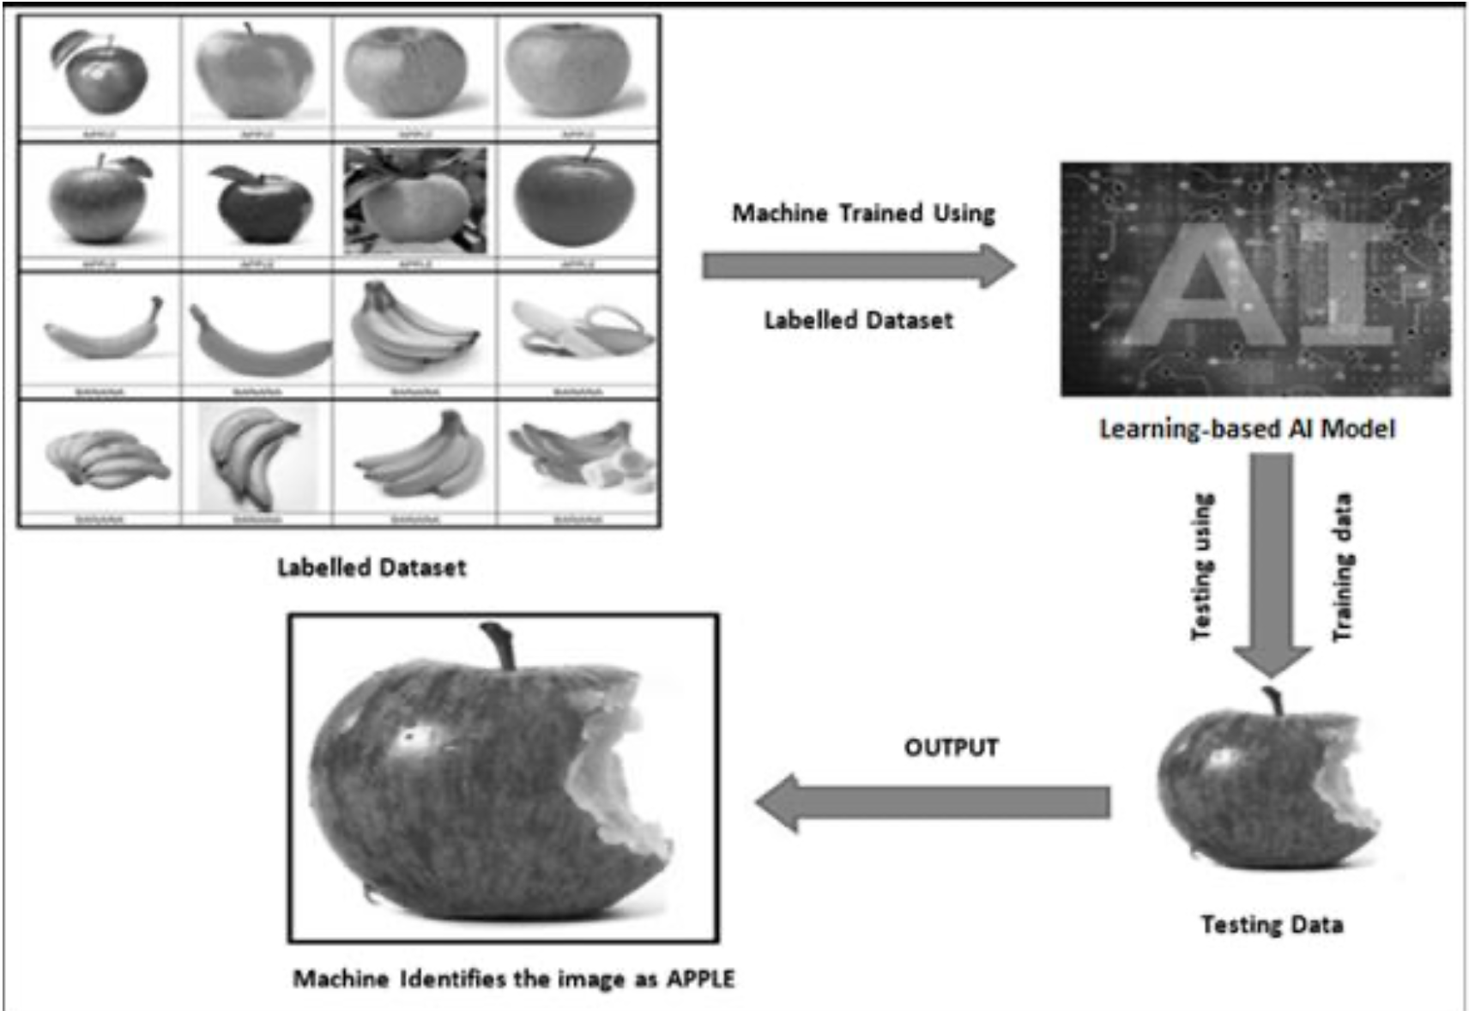
For example, suppose you have a dataset comprising of 100 images of apples and bananas each. These images depict apples and bananas in various shapes and sizes. These images are then labelled as either apple or banana so that all apple images are labelled 'apple' and all the banana images have 'banana' as their label. Now, the Al model is trained with this dataset and the model is programmed in such a way that it can distinguish between an apple image and a banana image according to their features and can predict the label of any image which is fed to it as an apple or a banana. After training, the machine is now fed with testing data. Now, the testing data might not have similar images as the ones on which the model has been trained. So, the model adapts to the features on which it has been trained and accordingly predicts if the image is of an apple or banana.
2.Learning based Approach
Refers to the Al modelling where the machine learns by itself.
Under the Learning Based approach, the Al model gets trained on the data fed to it and then is able to design a model which is adaptive to the change in data
That is, if the model is trained with X type of data and the machine designs the algorithm around it, the model would modify itself according to the changes which occur in the data so that all the exceptions are handled in this case.

Slide 10
AI Modelling
AI Models
Rule-based Approach
Learning Approach
Supervised
Un-Supervised
Reinforcement
Classification
Regression
Clustering
Association

Slide 11
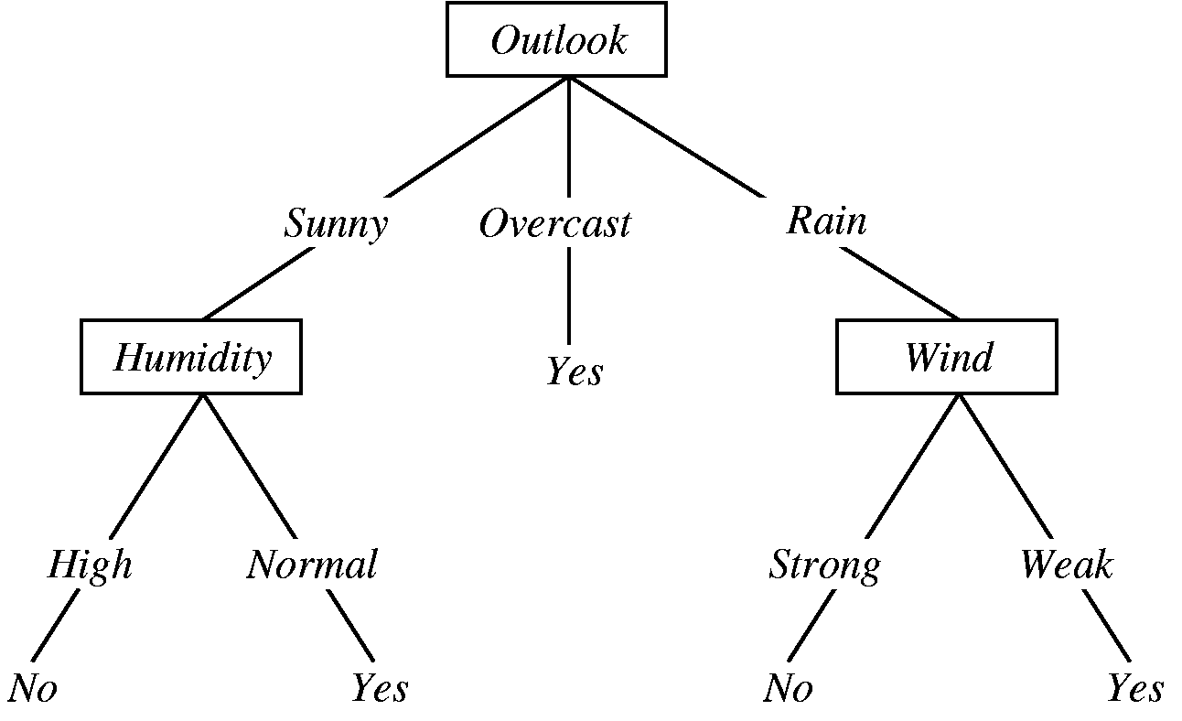
What is a Decision Tree?
A decision tree is a supervised machine learning algorithm that resembles a flowchart-like structure. It’s a graphical representation of a decision-making process that involves splitting data into subsets based on certain conditions. These conditions are learned from the input features and their relationships with the target variable.
Here’s a simplified example:
Imagine you want to build a decision tree to predict whether a person will play tennis based on weather conditions. The decision tree might start with the question, “Is it sunny?” If the answer is “yes,” you move down one branch of the tree; if it’s “no,” you move down another branch. At each node, you ask a question based on a feature, such as humidity or wind speed, until you reach a leaf node, which provides the final prediction (e.g., “Play tennis” or “Don’t play tennis”).

Slide 12
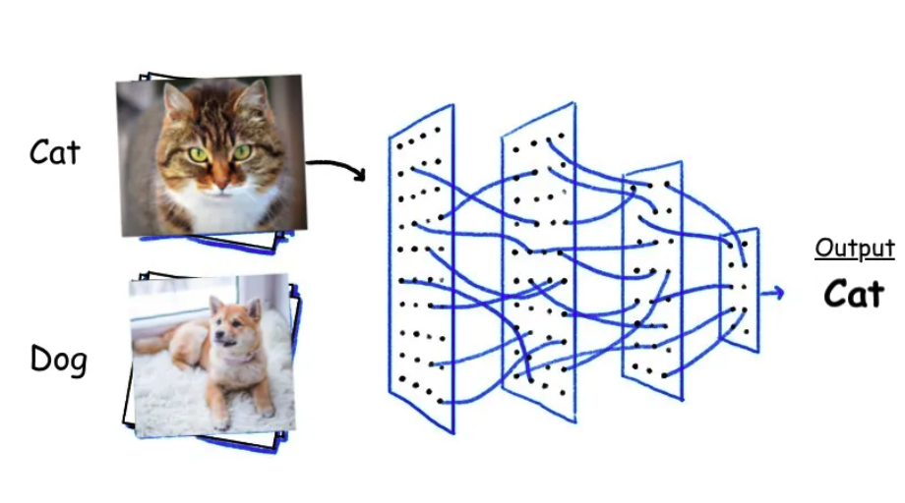
What is an Image Classification Model?
An image classification model is a type of computer program that has learned to recognize and sort images into different categories or labels.
Image classification involves assigning a label or category to an image or video. The goal is to accurately classify an image into a specific pre-defined category or label. This is done by training a machine learning model with a dataset of images that have been labeled with their respective categories. Once the model has been trained, it can be used to predict the category or label of new, unseen images.

Slide 13
AI Modelling
AI Models
Rule-based Approach
Learning Approach
Supervised
Un-Supervised
Reinforcement

Slide 14
Evaluation
https://youtu.be/WrfyzSiUj2I?feature=shared

